Slide 1
Weekly report
Doan Manh Hung

Slide 2
Last Week
- Rectangular cross section – Shear force bending(2DOF)

Slide 3
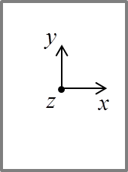












This week
Cross section
Case1: 2dof
$${ψ_{s}}^{Vx}=\left\{\begin{matrix}\begin{matrix}0 \\ −1\end{matrix} \\ \begin{matrix}0 \\ 1\end{matrix}\end{matrix}\right\}$$
$${ψ_{s}}^{βy}=\left\{\begin{matrix}\begin{matrix}−b/2 \\ s\end{matrix} \\ \begin{matrix}b/2 \\ −s\end{matrix}\end{matrix}\right\}$$
F_{x}
A
L
F_{x}
$$Vx$$
$$βy$$
$$s_{2}$$
$$βy$$
$$z_{2}$$
$$s_{1}$$
$$z_{1}$$
$$s_{3}$$
$$z_{3}$$
$$z_{4}$$
$$s_{4}$$

Slide 4
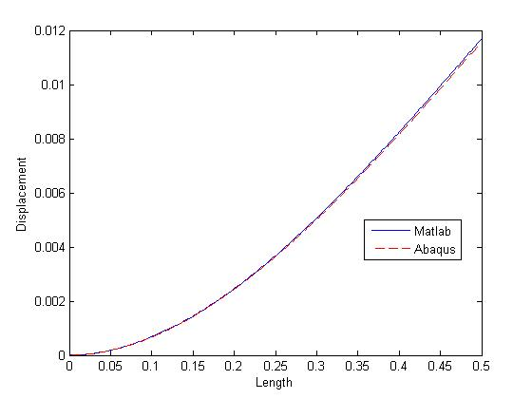
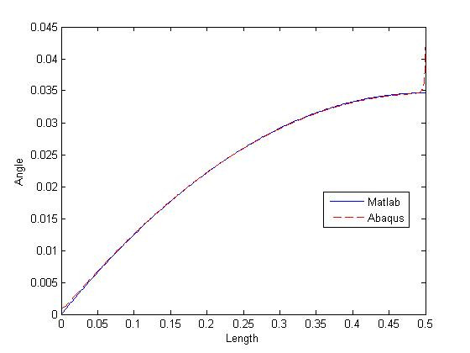
Result
Compare the displacement and angle result between MATLAB and ABAQUS :

Slide 5
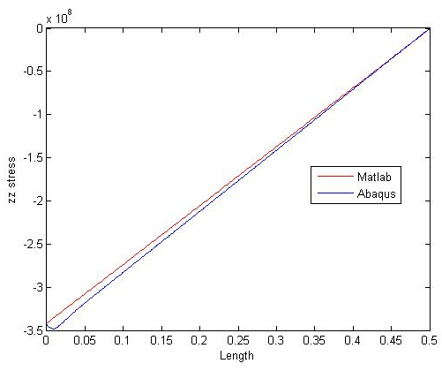
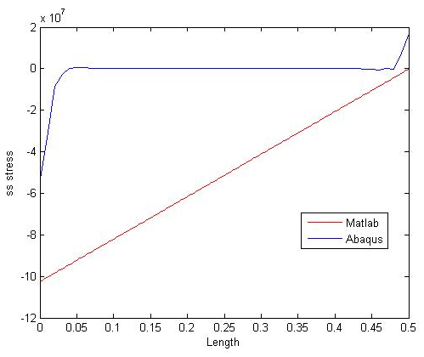
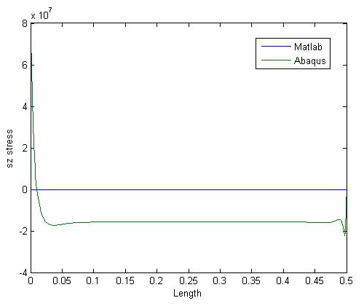
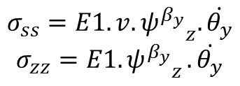
Stress
$$σ_{ss}=E1.v.{ψ^{β_{y}}}_{z}.\dot{θ_{y}}$$
$$σ_{zz}=E1{.ψ^{β_{y}}}_{z}.\dot{θ_{y}}$$
Compare the plane stress result between MATLAB and ABAQUS

Slide 6
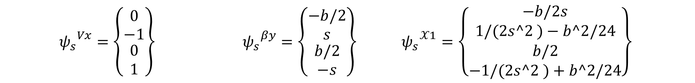



$${ψ_{s}}^{Vx}=\left\{\begin{matrix}\begin{matrix}0 \\ −1\end{matrix} \\ \begin{matrix}0 \\ 1\end{matrix}\end{matrix}\right\} {{ ψ}_{s}}^{βy}=\left\{\begin{matrix}\begin{matrix}−b/2 \\ s\end{matrix} \\ \begin{matrix}b/2 \\ −s\end{matrix}\end{matrix}\right\}{{ ψ}_{s}}^{𝒳1}=\left\{\begin{matrix}\begin{matrix}−b/2s \\ 1/(2s^2 )−b^2/24\end{matrix} \\ \begin{matrix}b/2 \\ −1/(2s^2 )+b^2/24\end{matrix}\end{matrix}\right\}$$
Cross section
Case1: 3dof
F_{x}
A
L
F_{x}
$$Vx$$
$$βy$$
$$χ_{1}$$
$$s_{2}$$
$$βy$$
$$z_{2}$$
$$s_{1}$$
$$z_{1}$$
$$s_{3}$$
$$z_{3}$$
$$z_{4}$$
$$s_{4}$$

Slide 7
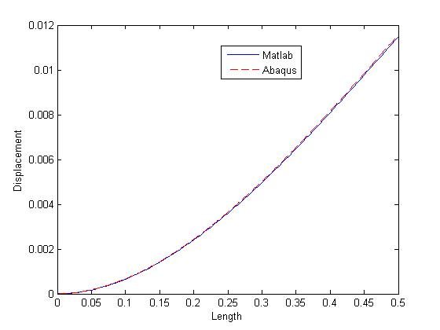
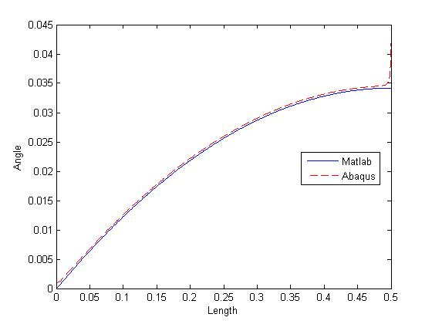
Result
Compare the displacement and angle result between MATLAB and ABAQUS :

Slide 8
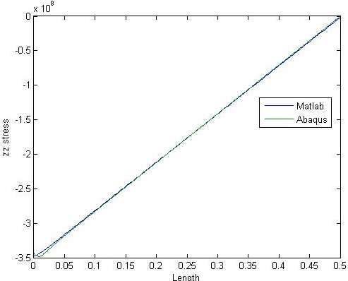
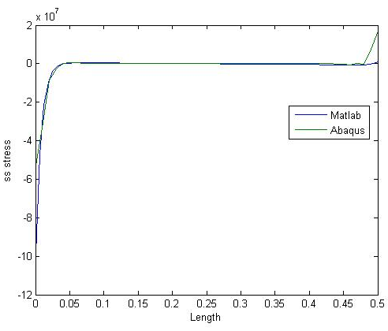
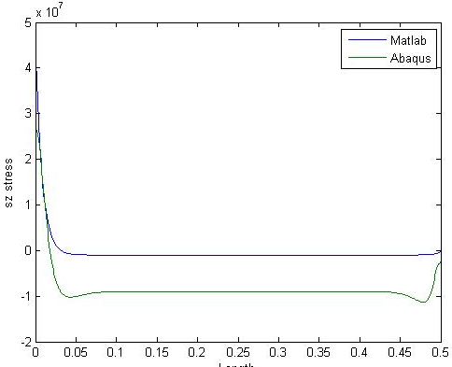
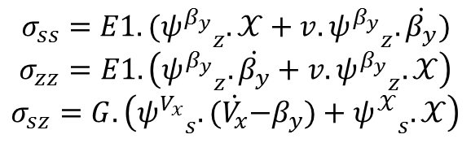
Stress
$$σ_{ss}=E1.({ψ^{β_{y}}}_{z}.𝒳+v.{ψ^{β_{y}}}_{z}.\dot{β_{y}})$$
$$σ_{zz}=E1.\left({ψ^{β_{y}}}_{z}.\dot{β_{y}}+v.{ψ^{β_{y}}}_{z}.𝒳\right)$$
$$σ_{sz}=G.\left({ψ^{V_{x}}}_{s}.(\dot{V_{x}}{−β}_{y})+{ψ^{𝒳}}_{s}.𝒳\right)$$
Compare the plane stress result between MATLAB and ABAQUS

Slide 9
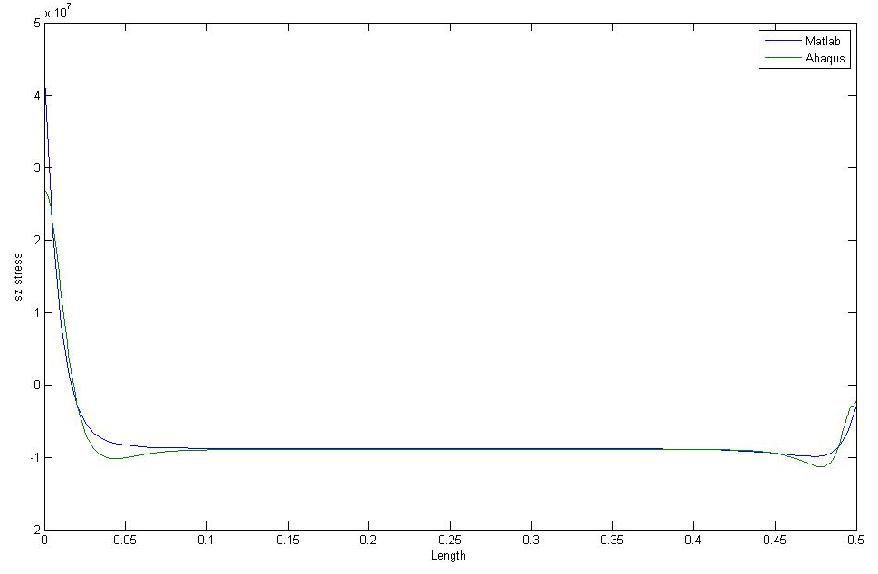
Next week
Case1: 4dof
Cross section
A
F_{x}
L
F_{x}

